Slide 1

Solving 16-Queen Problem Using Genetic-Algorithm
By
Sayeed Anwar Syed Kamal
31510156

Slide 2
Introduction
Genetic Algorithm - A genetic algorithm is a search heuristic that is inspired by Charles Darwin's theory of natural evolution.
It is used to solve both constrained and unconstrained optimization problems.
The genetic algorithm repeatedly modifies a population of individual solutions.
At each iteration, the genetic algorithm selects individuals probabilistically from the current population and uses them to produce the children for the next generation.
Over successive generations, the population "evolves" toward an optimal solution.
Note: Heuristics are a problem-solving method that uses shortcuts to produce good-enough solutions given a limited time frame or deadline.

Slide 3
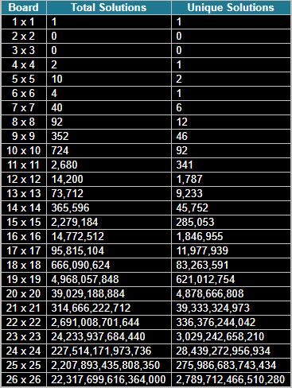
Problem Domain
The 16-Queen problem is the problem of placing 16 queens on a 16×16 chessboard such that none of them attack one another.
Brute force or exhaustive search can be resource intensive.
Genetic Algorithm is a part of class of stochastic optimization algorithms, which can produce a good solution more effectively and efficiently compared to brute force.
On the right is a table that shows the number of possible solutions for different chess board dimensions.
It is observed that genetic algorithms work better for higher dimension or large search space problems.

Slide 4
Does solving this problem have any significance?
16-Queen Problem is a permutation type problem.
Permutation problem is a common problem that we face on a day-to-day basis.
Example 1: Network routing protocol, which finds a good routing path for the IP packets.
Example 2: Finding the shortest path for an airplane, which helps in saving fuel and time.
Simply by altering the fitness function and few other parts of the program we can solve other types of permutation problems like knap sack problem or traveling salesman problem.

Slide 5
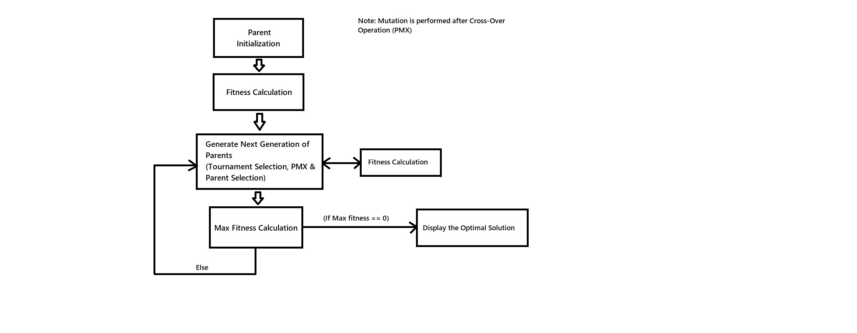
Algorithm

Slide 6
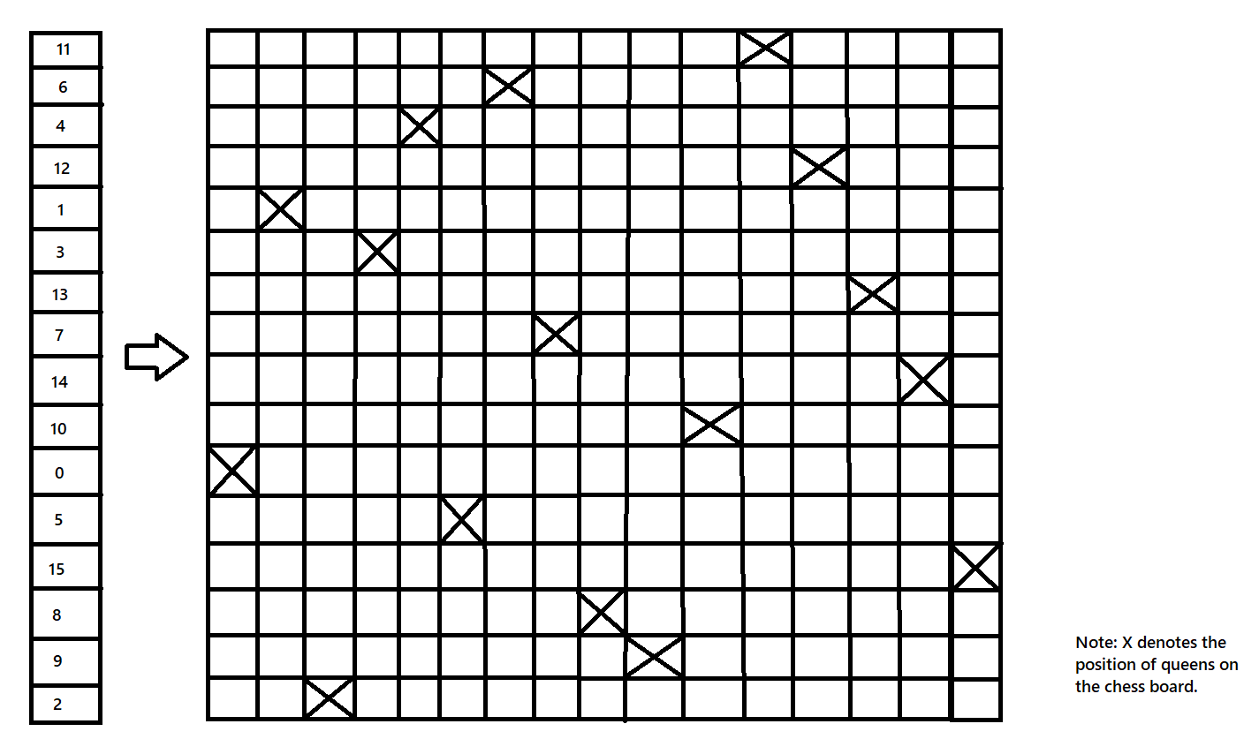
Problem Representation
The array on the left is the parent from the code and the cross (X) mark in the respective row in the matrix on the right represents its physical position on a 16x16 chess board.
Since the parent is a row vector, we don’t have to worry about searching horizontally.
Such reduced form of representation helps in reducing the code complexity.

Slide 7
Essential Functions defined
Defined a parent initialization function.
Defined a fitness function.
Defined a tournament selection function.
Defined a cross-over (pmx) function
Defined a mutation (swap mutation) function.
Defined a parent selection function.

Slide 8
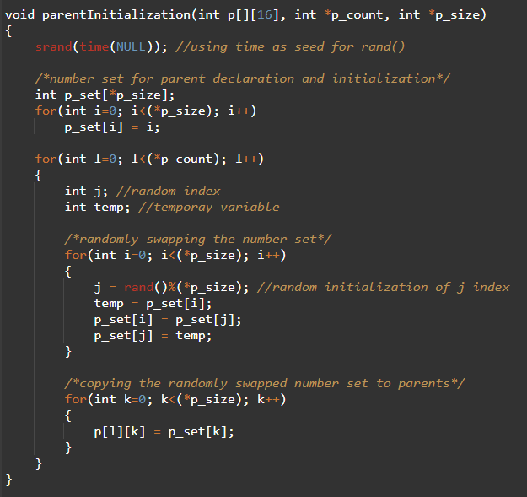
Parent initialization function
It creates an array of numbers based on the value of p_size, for example if p_size = 16 then it will create an array integers from 0 to 15.
A random generator is used to randomly rearrange the array.
The rearranged number set is copied to the parent array.
This is done till we have p_count number of parents. p_count, is the number of parents in a generation.

Slide 9
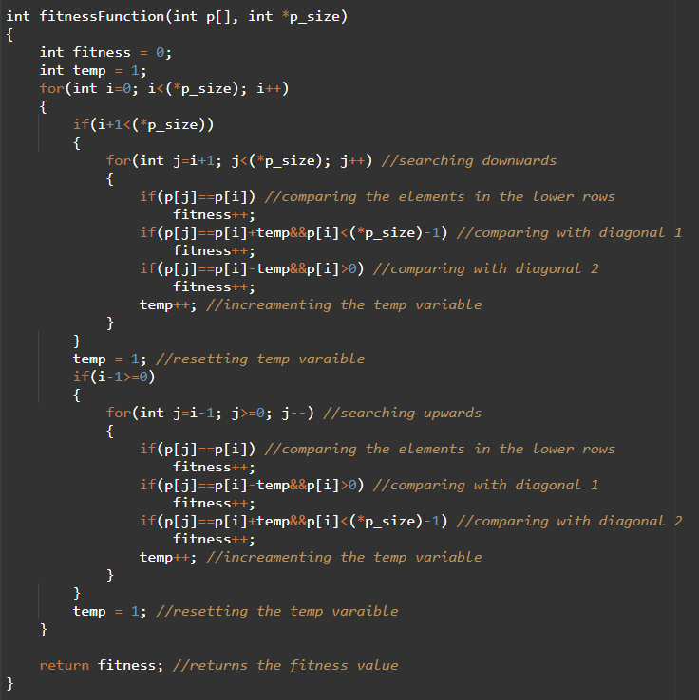
Fitness Function
This function takes a parent array and its size as arguments and returns the fitness of that parent.
The first for loop performs a downward search looking for diagonal and vertical clashes.
The second for loop performs an upward search looking for diagonal and vertical clashes.
Boundary conditions are applied to upward and downward searches.

Slide 10
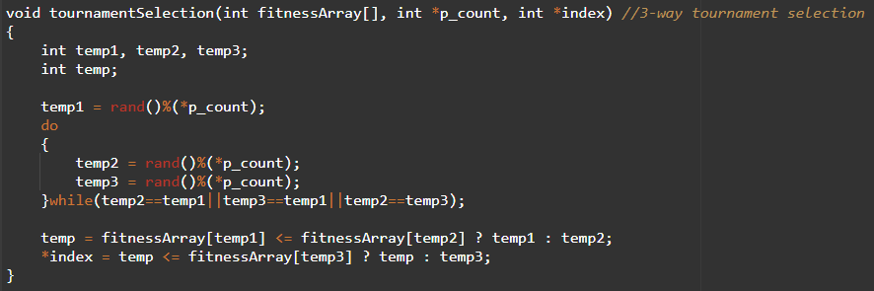
Tournament selection
This function takes the fitness array, parent count and an index variable as an argument and gives a value for the index variable.
Using a random generator, it generates three indexes for parent fitness array and compares their fitness values.
The fittest index gets copied to the index variable.

Slide 11
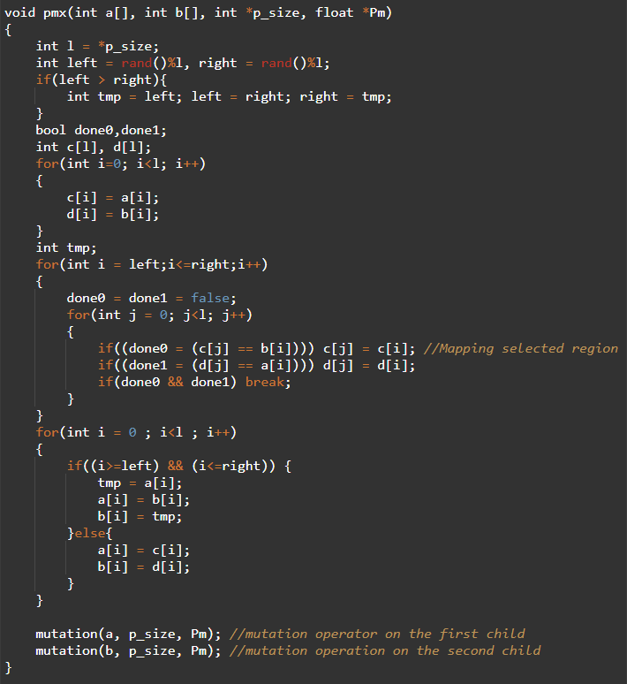
Cross-over (PMX) Function
This function takes two arrays, parent size (p_size) and mutation rate (Pm) as an argument and returns two children.
After performing the PMX operation mutation is performed on each child.
The PMX function calls another function called mutation(), which performs mutation on the specified child array.

Slide 12
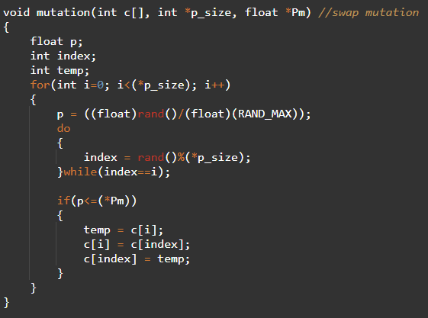
Mutation function
This function takes a parent array, parent array size and the mutation rate.
For each element of the parent array, we generate a probability (p) and a random index.
If the probability of p is less than or equal to mutation rate (Pm) it performs a simple swap mutation between two indexes of the parent array.

Slide 13
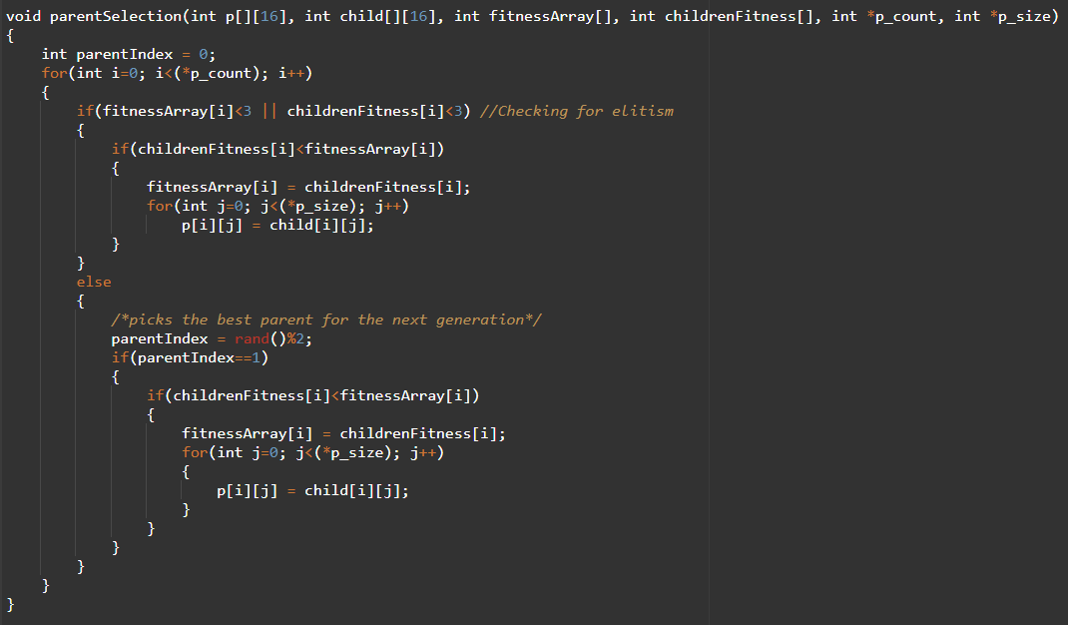
PARENT SELECTION Function
This function takes previous parent matrix, child matrix, parent fitness array, children fitness array, parent count and parent size as an argument.
Checks if either the parent or the children fitness is less than 3 if true, copies the best solution into the parent array.
Else looks for a random choice between the parent and the child.
For parent index = 1 it checks if the child fitness is less than the parent fitness. If true copies the child into the parent.

Slide 14
performance Tunning
Population Size
Mutation Rate
Parent Selection Function
Random Generator Quality

Slide 15
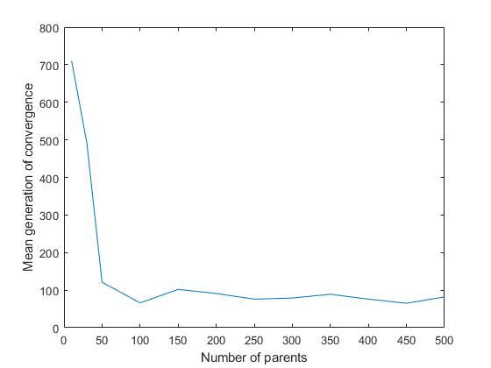
Parent Size
As we increase the parent size the mean generation of convergence decreases.
Mutation Rate = (1/pop_size + 1/parent_size).
The graph gets flatter as the population size >150.
It suggests that there is no drastic performance increase beyond the population size of 150.
Therefore, we can obtain an optimal solution efficiently with a small population size around 200 – 300.
Note: The mean generation of convergence was calculated by running the program 10 times.

Slide 16
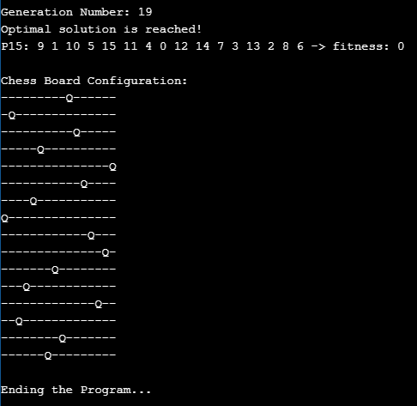
Mutation Rate
Population size = 200, Parent Size = 16, Mutation rate = 0 and Maximum Number of Iteration = 500000.
Converges to the global optimum.
It suggests that since the population size is big it nearly covers most of the possible seeds and reaches the global optimum even without the influence of mutation.

Slide 17
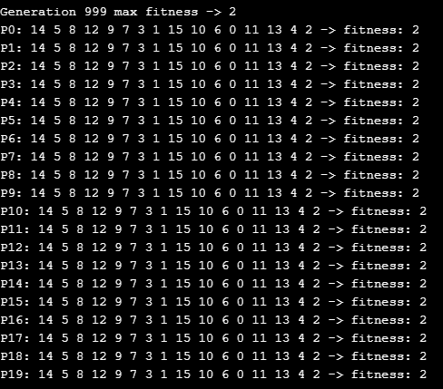
Mutation Rate
Population size = 20, Parent Size = 16, Mutation rate = 0 and Maximum Number of Iteration = 500000.
Doesn’t Convergence, gets trapped at the local optimum.
It suggests that for smaller population size mutation can help in getting out of the local optimum and converge to the global optimum.

Slide 18
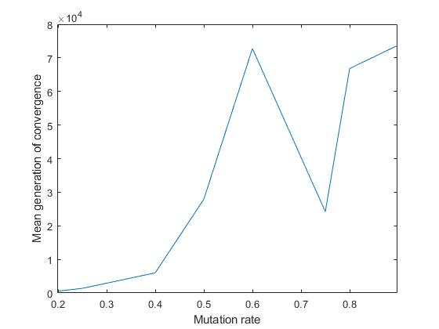
Mutation Rate
Population size = 20, Parent Size = 16, Mutation rate = 0 (initial condition) and Maximum Number of Iteration = 500000.
For smaller population it is seen that increasing the mutation rate leads to increase in the mean generation of convergence.
Hypothetically we can say that the mutation rate is so high which causes a bottleneck that is it is not able to permute through a given search area effectively.

Slide 19
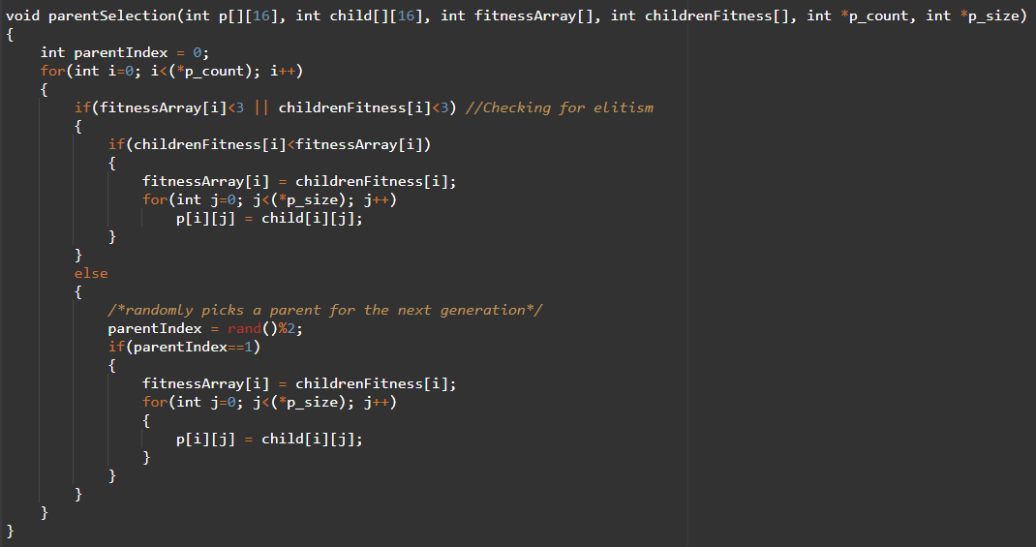
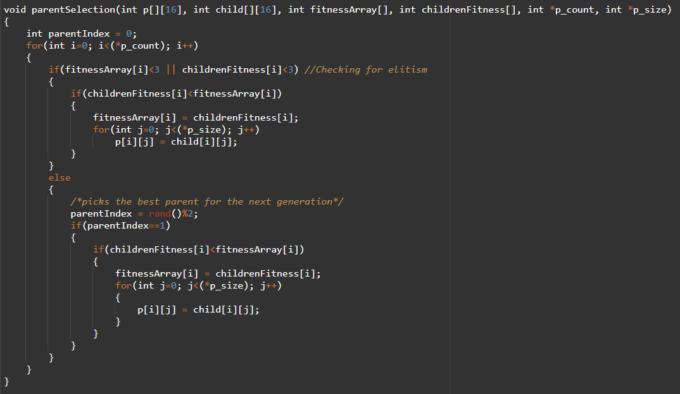
Parent Selection Function
The left function is called parent selection function 1 and the right function is called parent selection function 2.
The parent selection function 1 chooses the parent for the next generation based of a random generator and the parent selection function 2 favors the child if its fitness value is greater than the previous parent fitness value.

Slide 20
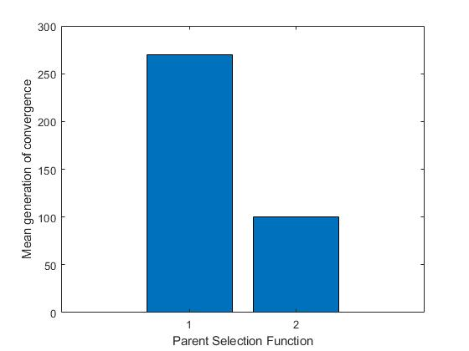
Parent Selection Function
From this bar graph parent selection function 2 is better than parent selection function 1.
Hypothetically it says that selection operator must favor the one with higher fitness value.
Parent selection function 2 was modeled based on tournament selection.

Slide 21
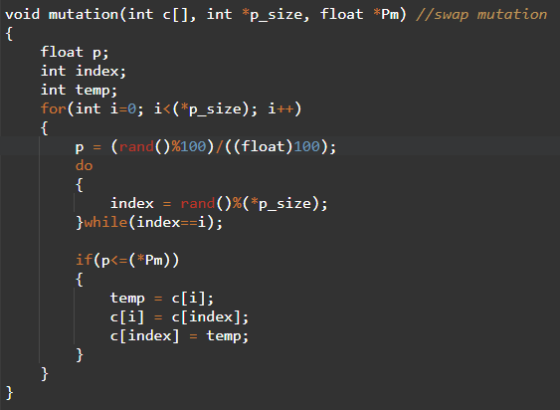
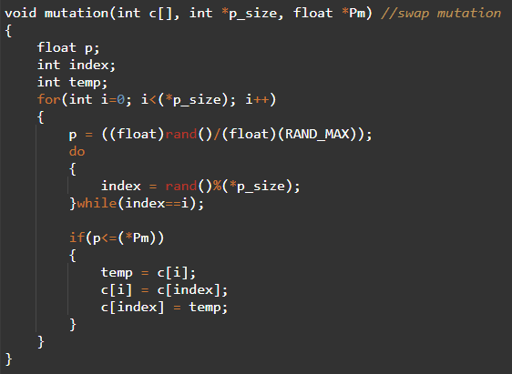
Random Generator Quality
Left random generator is called random generator 1 and the right random generator is called random generator 2.
The random generator on the right has more precision than the random generator on the left.

Slide 22
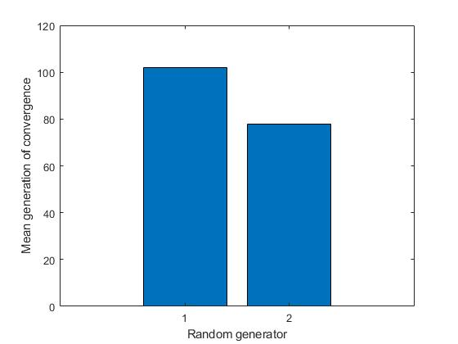
Random generator Quality
Random generator 2 shows lower mean generation of convergence or it converges faster.
This is the case because random generator with higher precision can trigger mutations more precisely.

Slide 23
Scope of Modifications
Roulette wheel can be used for selecting candidates for mating pool and parents for the next generation. Which will improve the performance of the algorithm.
Use of vectors (dynamic arrays or list) instead of static arrays will enable the program to solve n-queen problem.
Use of a sophisticated mutation operator can help the problem to converge faster.
Parents can be sorted based on their fitness values to observe changes in the performance.

Slide 24
Language / Tools / Environment Used
Language - C++
Tool - Online C++ Compiler
Environment - https://www.onlinegdb.com/online_c++_compiler

Slide 25
References
https://www.geeksforgeeks.org/genetic-algorithms/
https://github.com/rachit95arora/travelling-salesman-openmp/blob/master/src/pmx.cpp
http://datagenetics.com/blog/august42012/index.html

